Slide 1
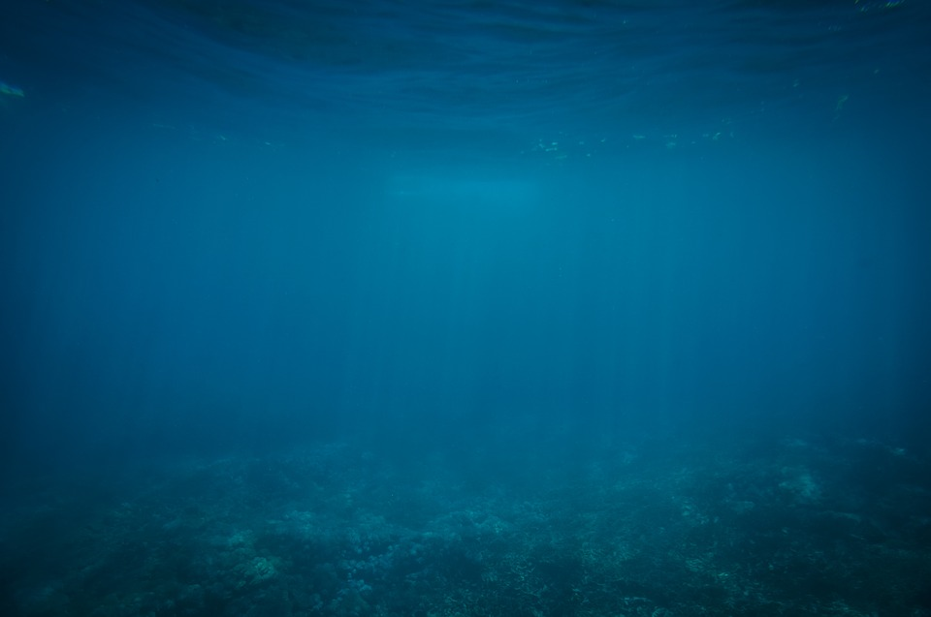
Deeper into Computer Vision

Slide 2
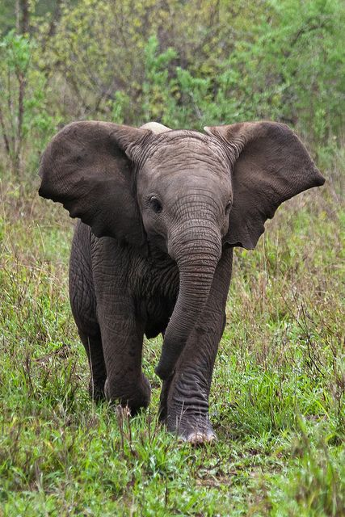
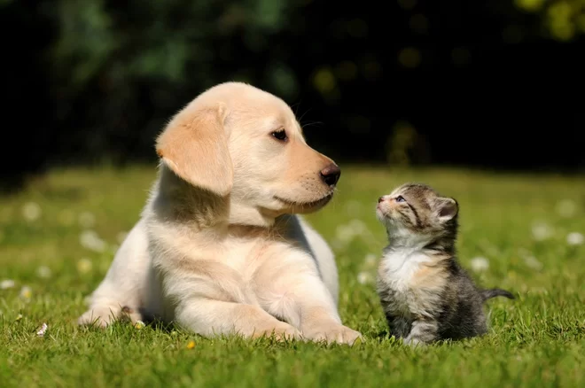
Elephant
Dog
Cat
Object Localization
Object Detection

Slide 3
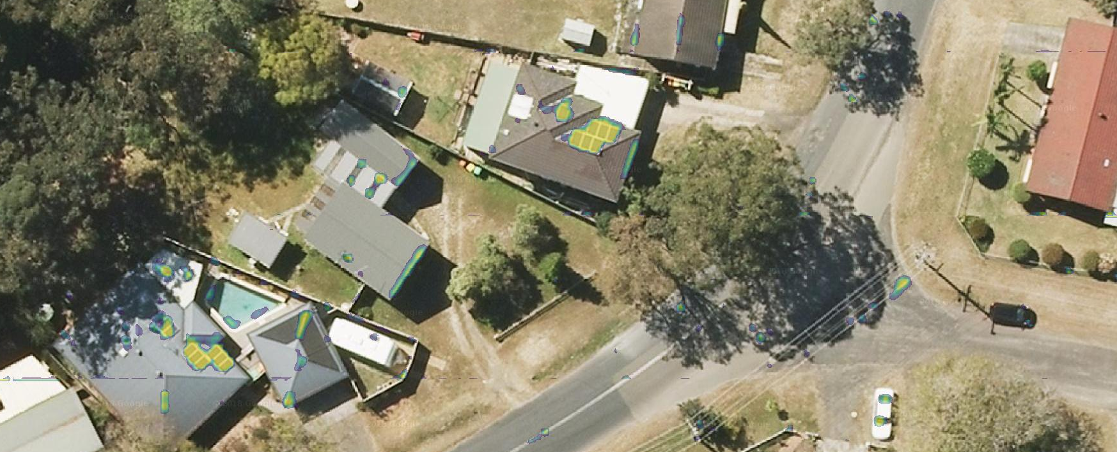
Where are the roads?

Slide 4
Where are the roads?
We can not use a rectangle to get the ‘right’ location

Slide 5
Semantic Segmentation
Understanding image at more granular level

Slide 6
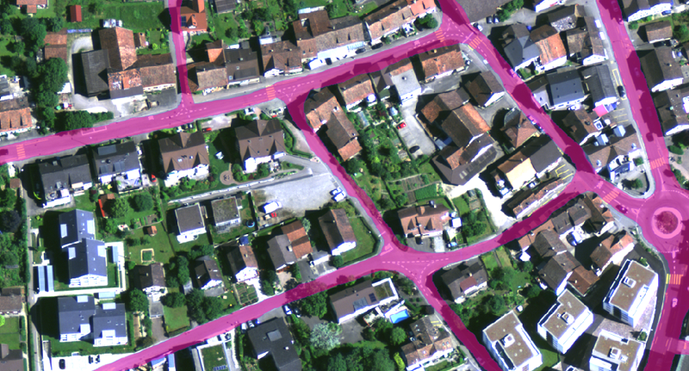
Road identification in Satellite imagery

Slide 7
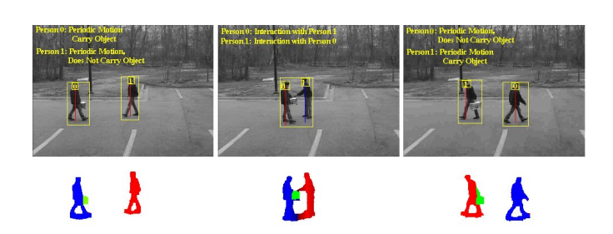
Activity Recognition

Slide 8
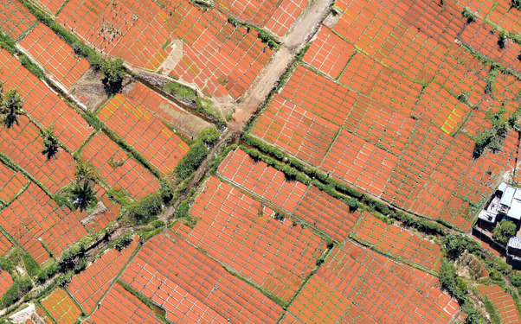
Crop
Monitoring

Slide 9
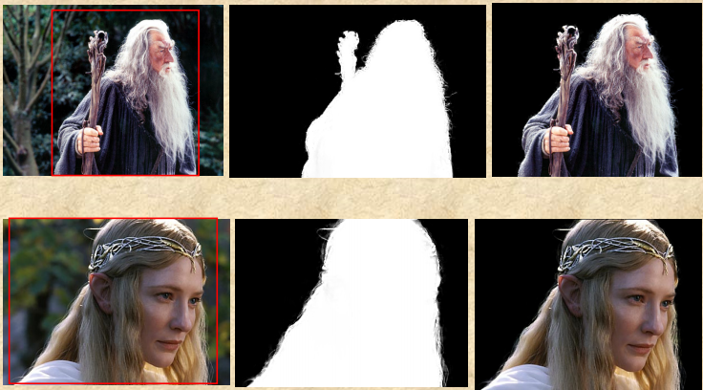
Object Extraction

Slide 10
How to perform Semantic Segmentation?

Slide 11
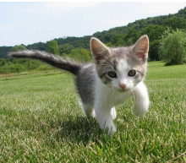
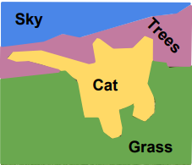
Semantic Segmentation
Classify each Pixel

Slide 12
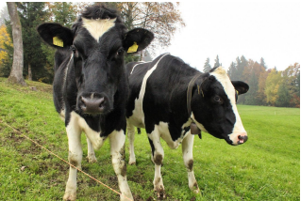
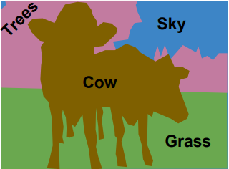
Semantic Segmentation
Does not differentiate between multiple instances of same object

Slide 13

What is the model’s output in Semantic Segmentation?

Slide 14
Semantic Segmentation
Input Image
Output Mask
We will need to classify each pixel in the input image

Slide 15
Size of the output?
Input Image
Output Mask
Width of input image x Height of input image x Number of classes

Slide 16
How to build an ML model for Semantic Segmentation?

Slide 17

VGG Network
Typically we start with an image and reduce width and height progressively
For Semantic Segmentation, we need width and height same as input image.
Source: researchgate.net

Slide 18
How to do get output with same width and height as input image?

Slide 19
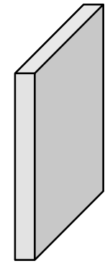
Fully Convolutional @Image Resolution
Model Output
argmax
200x200x3
Size?
Size?
200x200xD₁
200x200xD₂
200x200xD₃
200x200xC
200x200x1
But Convolution at image resolution are computationally very expensive

Slide 20

Fully Convolutional : Alternate approach
High Resolution
200x200xD₁
Medium Res
100x100xD₂
Low Res
50x50xD₃
Low Res
50x50xD₃
200x200x3
Medium Res
100x100xD₂
High Resolution
200x200xD₁
Down Sampling and then Up Sampling
Reduces number of computations significantly

Slide 21
Fully Convolutional
Encoder
Decoder
Encoder - Decoder Architecture
Down Sampling and then Up Sampling

Slide 22
How do we downsample image?

Slide 23
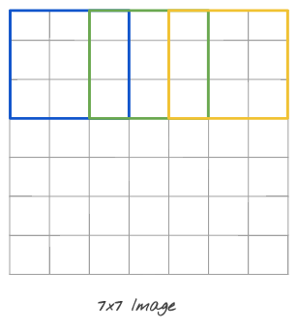
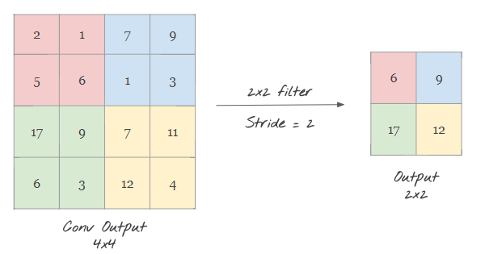
Down Sampling
Max Pooling
Striding

Slide 24
How do we upsample image?
Transpose Convolution

Slide 25
Similar to convolution, it has filter
2 | 1 | 4
1 | 0 | 0
0 | 3 | 1
2 | 1
1 | 4
Input 2x2
Filter 3x3
Transpose Convolution

Slide 26
Transpose Convolution
Each number in input gets multiplied by all the numbers in filter...generating 9 numbers here
2x2 | 1x2 | 4x2
1x2 | 0x2 | 0x2
0x2 | 3x2 | 1x2
2 | 1 | 4
1 | 0 | 0
0 | 3 | 1
2 | 1
1 | 4
Output
Input 2x2
Filter 3x3
3x3 transpose convolution, stride 2

Slide 27
Transpose Convolution
4 | 2 | 8
2 | 0 | 0
0 | 6 | 2
2 | 1 | 4
1 | 0 | 0
0 | 3 | 1
2 | 1
1 | 4
Output
Input 2x2
Filter 3x3
3x3 transpose convolution, stride 2

Slide 28
Transpose Convolution
Take 2nd number and multiply with filter numbers. Put numbers in output based on stride.
4 | 2 | 8
2 | 0 | 0
0 | 6 | 2
2 | 1 | 4
1 | 0 | 0
0 | 3 | 1
2 | 1
1 | 4
Output
Input 2x2
Filter 3x3
3x3 transpose convolution, stride 2

Slide 29
Transpose Convolution
Take 2nd number and multiply with filter numbers. Put numbers in output based on stride.
4 | 2 | 8+2x1 | 1x1 | 4x1
2 | 0 | 0+1x1 | 0x1 | 0x1
0 | 6 | 2+0x1 | 3x1 | 1x1
2 | 1 | 4
1 | 0 | 0
0 | 3 | 1
2 | 1
1 | 4
Input 2x2
Filter 3x3
Output 5x5
3x3 transpose convolution, stride 2

Slide 30
Transpose Convolution
Overlapping numbers are added together...
4 | 2 | 10 | 1 | 4
2 | 0 | 1 | 0 | 0
0 | 6 | 2 | 3 | 1
2 | 1 | 4
1 | 0 | 0
0 | 3 | 1
2 | 1
1 | 4
Input 2x2
Filter 3x3
Output 5x5
3x3 transpose convolution, stride 2

Slide 31
Fully Convolutional
Down Sampling:
Max Pool, Strided Convolution
Up Sampling:
Transpose Convolution
High Resolution
200x200xD₁
Medium Res
100x100xD₂
Low Res
50x50xD₃
Low Res
50x50xD₃
200x200x3
Medium Res
100x100xD₂
High Resolution
200x200xD₁

Slide 32
128x128x16
128x128x3
128x128xC
128x128xx16
64x64x32
64x64x16
64x64xx32
64x64xx32
Convolutional Layers
32x32x64
32x32x32
32x32x64
MaxPool
2x2
32x32x64
Transpose
Convolution
UNet Architecture
16x16x64
Skip Connection
16x16x128

Slide 33
How to build data for Semantic Segmentation?
Use LabelMe tool
https://github.com/wkentaro/labelme

Slide 34
Installing LabelMe tool
pip install labelme
Available for windows, MacOS and Linux

Slide 35
Using LabelMe
Enter ‘labelme’ on command prompt to open GUI
Once an image is annotated and saved, a json file is created for the image.

Slide 36
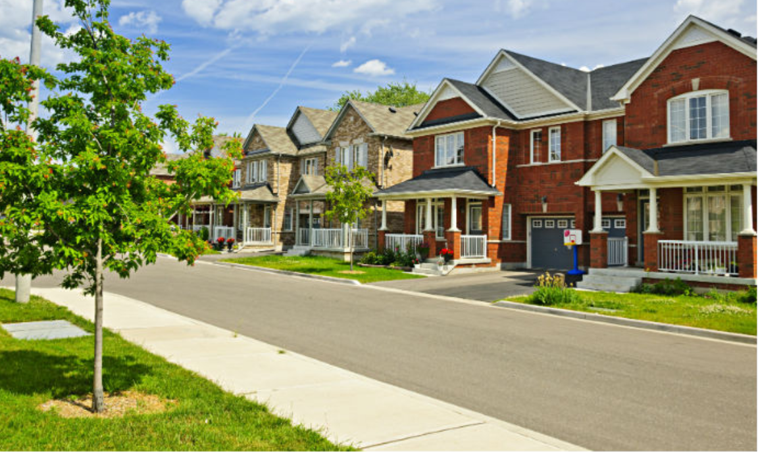

What is an Actual Label in Semantic Segmentation task?
Input image
Mask (Actual Label)
Mask is made of Label Ids e.g 0, 1, 2 ..etc

Slide 37
How do we create Masks using LabelMe?
Annotate all images in your dataset.
Store images and generated json in one folder e.g ‘data_annotated’
Clone git repository https://github.com/wkentaro/labelme
Go to ‘Examples/semantic_segmentation folder
Run the following command
python labelme2voc.py data_annotated output_dataset --labels <label_file_path>
data_annotated → folder where annotated images and json is kept
output_dataset → folder where output will be generated
<label_file_path> → list of all classes

Slide 38
How do we create Masks using LabelMe?
Folders created inside ‘output_dataset’ folder
JPEGImages : Original images
SegmentationClassPNG : Segmentation mask (Actual Label)

Slide 39
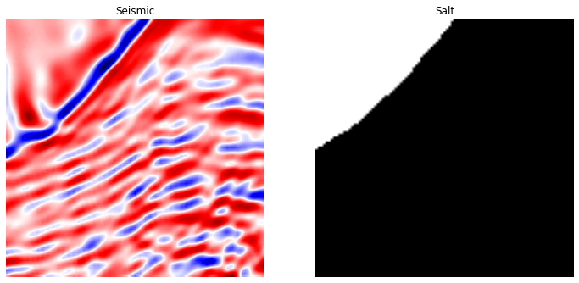
Exercise
Semantic Segmentation for TGS Salt Identification

Slide 40
Backup Slides

Slide 41
Unpooling
2 | 2 | 7 | 7
2 | 2 | 7 | 7
4 | 4 | 1 | 1
4 | 4 | 1 | 1
2 | 0 | 7 | 0
0 | 0 | 0 | 0
4 | 0 | 1 | 0
0 | 0 | 0 | 0
2 | 7
4 | 1
2 | 7
4 | 1
Nearest Neighbour
Bed of Nails

Slide 42
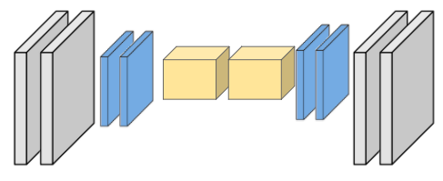
Max Unpooling
1 | 3 | 7 | 3
4 | 2 | 6 | 1
6 | 8 | 1 | 9
3 | 1 | 7 | 8
0 | 0 | 1 | 0
2 | 0 | 0 | 0
0 | 4 | 0 | 7
0 | 0 | 0 | 0
4 | 7
8 | 9
2 | 1
4 | 7
. . . .

